Slide 1
NHANES 2011–2016: Heavy Metal Exposure and
Disability
Machine Learning Model Comparison
Santhakumar Ramesh · University at Buffalo · October 2025
Comprehensive Model Comparison Presentation

Slide 2
Motivation
Even low-to-moderate exposure to heavy metals like lead and cadmium can impair
physical functioning. We study how metal biomarkers measured in NHANES
are associated with disability in U.S. adults.

Slide 3
Dataset Overview
• NHANES 2011–2016 (Cycles G, H, I) • Outcome: any_disability (derived from PFQ items) • N=8,956; Modeling sample=7,701; Prevalence≈16.1% • Features: 5 metal biomarkers (Lead, Cadmium, Mercury, Manganese, Selenium)
+ 2 Demographicz (Age , BMI)

Slide 4
Modeling Pipeline
Data cleaning →
Feature engineering →
Train/Test split →
Train 5 models (Logistic, RF, RF-Cal, XGB, XGB-Cal) →
Evaluate with ROC AUC, PR-AUC, Sensitivity, Specificity, Brier, Calibration →
Interpret feature effects & exposure risk.

Slide 5
Model 1 – Logistic Regression
Strong baseline with AUC≈0.77. Odds ratios highlight cadmium as a major risk factor;
calibration is acceptable and probabilities are informative.

Slide 6
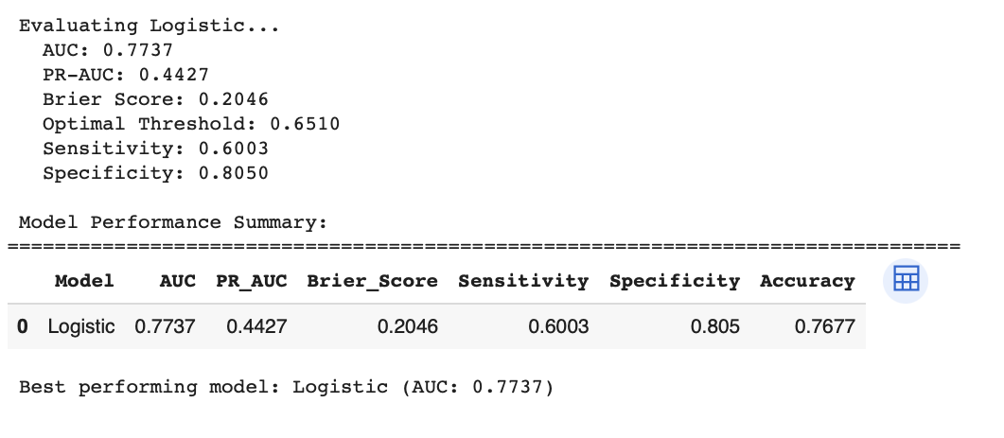
Interpretation: The logistic regression model achieved an AUC of 0.7737, indicating good discriminative ability between classes. Its optimal threshold (0.6510) resulted in a sensitivity of 0.6003 and a specificity of 0.8050, showing better performance in identifying negatives than positives. With an accuracy of 76.77% and a low Brier Score (0.2046), the model shows well-calibrated probabilistic predictions overall.

Slide 7
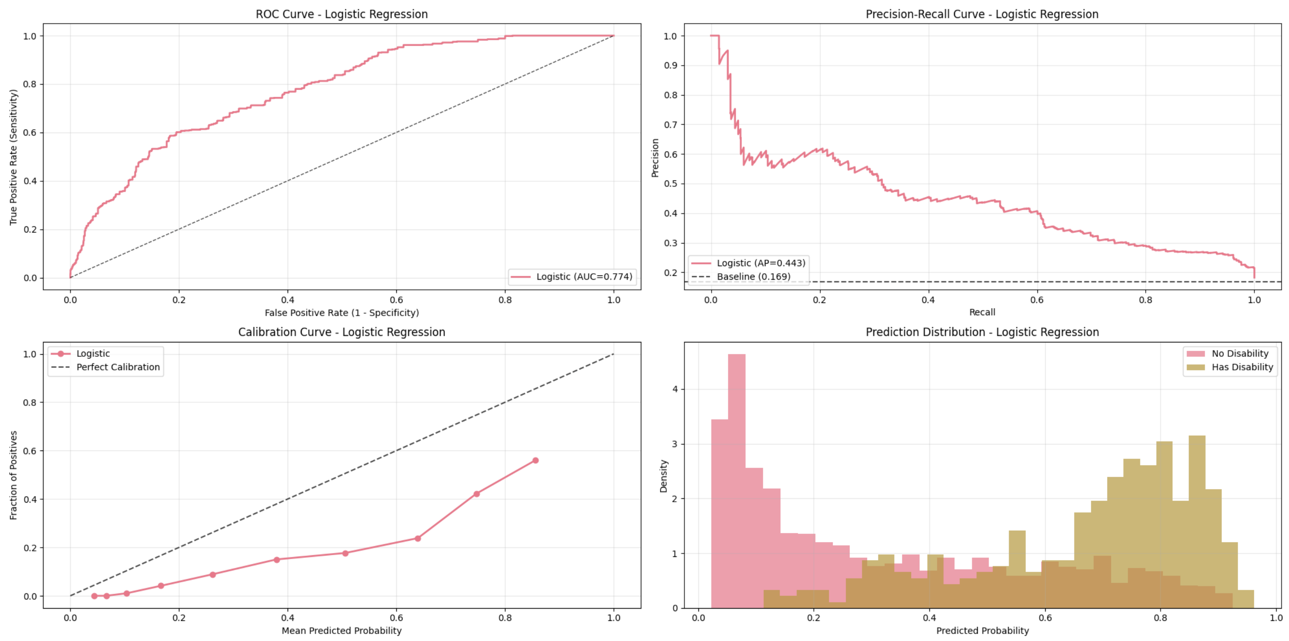
Interpretation: The logistic regression model shows strong class separation (AUC = 0.774) and moderate precision-recall performance (AP = 0.443), with better precision at lower recall levels. However, the calibration curve reveals slight underconfidence, and the prediction distribution shows distinct probability ranges for both classes, especially above 0.6 for "Has Disability."

Slide 8
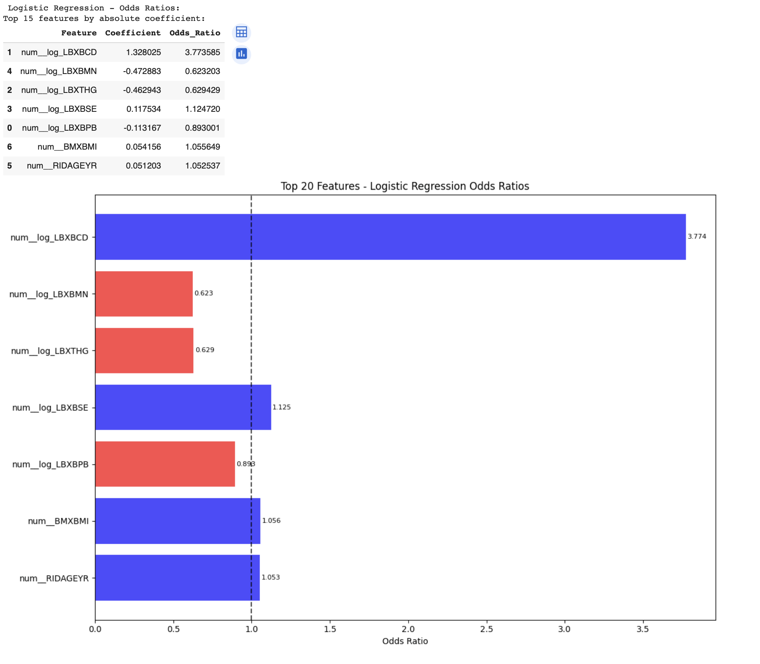
Interpretation: The top predictor num__log_LBXBCD (odds ratio = 3.77) significantly increases the likelihood of disability, while num__log_LBXBMN and num__log_LBXTHG (odds ratios < 1) are protective factors. Features with odds ratios above 1 increase the odds of disability, while those below 1 decrease it, highlighting both risk and protective biomarkers.

Slide 9
Model 2 – Random Forest
Captures nonlinearities and interactions, improving sensitivity. Feature importance confirms
Age, BMI, and Cadmium as dominant predictors.

Slide 10
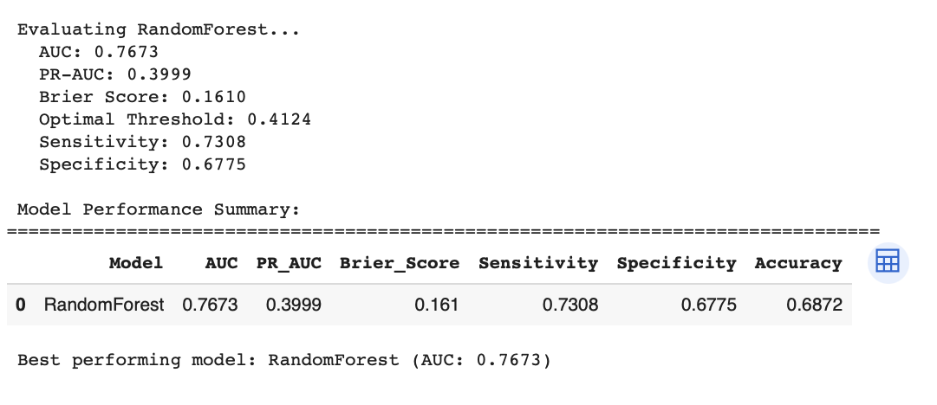
The Random Forest model achieved a good AUC of 0.7673 and a lower Brier Score (0.1610), indicating better probability calibration than logistic regression. It favored sensitivity (0.7308) over specificity (0.6775), suggesting it performs better at identifying true positives, though with a slight drop in overall accuracy (68.72%).

Slide 11
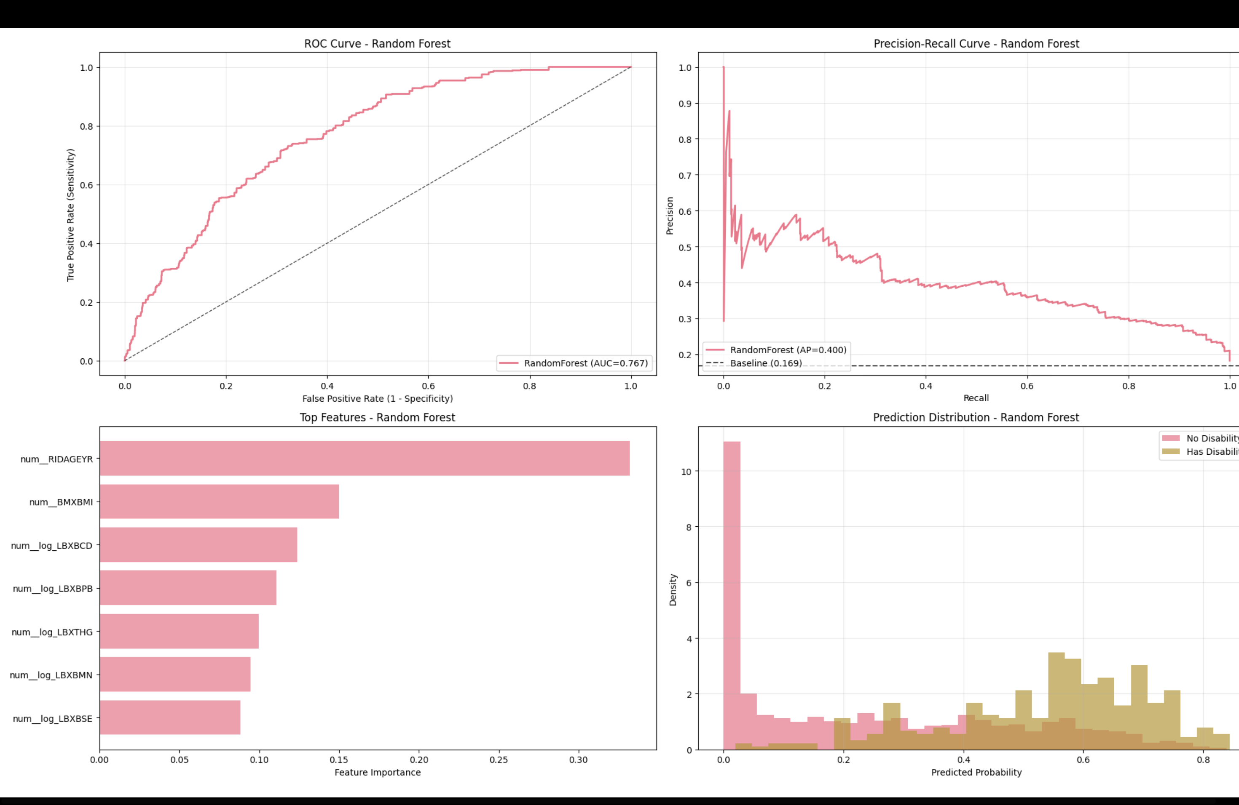
Interpretation: The Random Forest model shows similar AUC (0.767) to logistic regression but achieves higher sensitivity, making it better at detecting positives (e.g., disabilities). Feature importance highlights age (RIDAGEYR) and BMI (BMXBMI) as the top predictors, and the prediction distribution reveals clearer separation for "has disability" at higher probabilities.

Slide 12
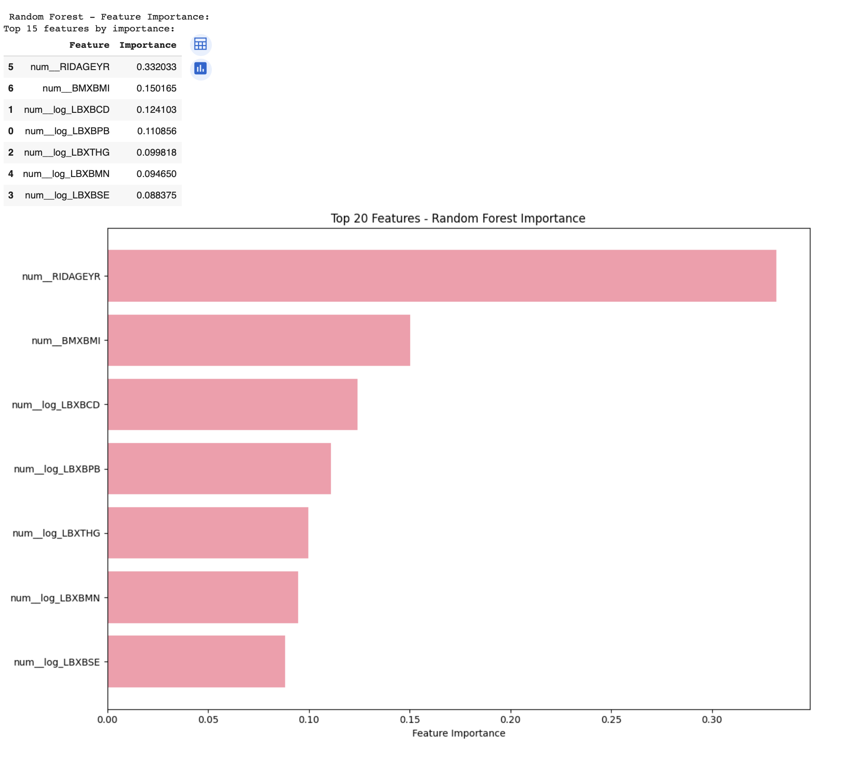
Interpretation: The top feature for Random Forest is age (RIDAGEYR), contributing the most (33%) to model decisions, followed by BMI and biomarker LBXBCD. These features hold the highest predictive power for identifying disability, highlighting their strong non-linear relationship with the target in the ensemble model.

Slide 13
Model 3 – Random Forest (Calibrated)
Calibration aligns probabilities with outcomes (lower Brier). Discrimination remains high;
key predictors are stable, strengthening trust in outputs.

Slide 14
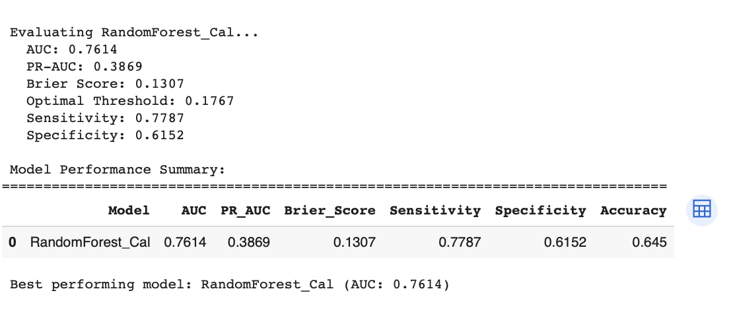
Interpretation: The calibrated Random Forest (RandomForest_Cal) maintains a strong AUC (0.7614) with the lowest Brier Score (0.1307), indicating well-calibrated probability estimates. It favors high sensitivity (0.7787), capturing more true positives, but this comes at the cost of reduced specificity (0.6152) and overall accuracy (64.5%).

Slide 15
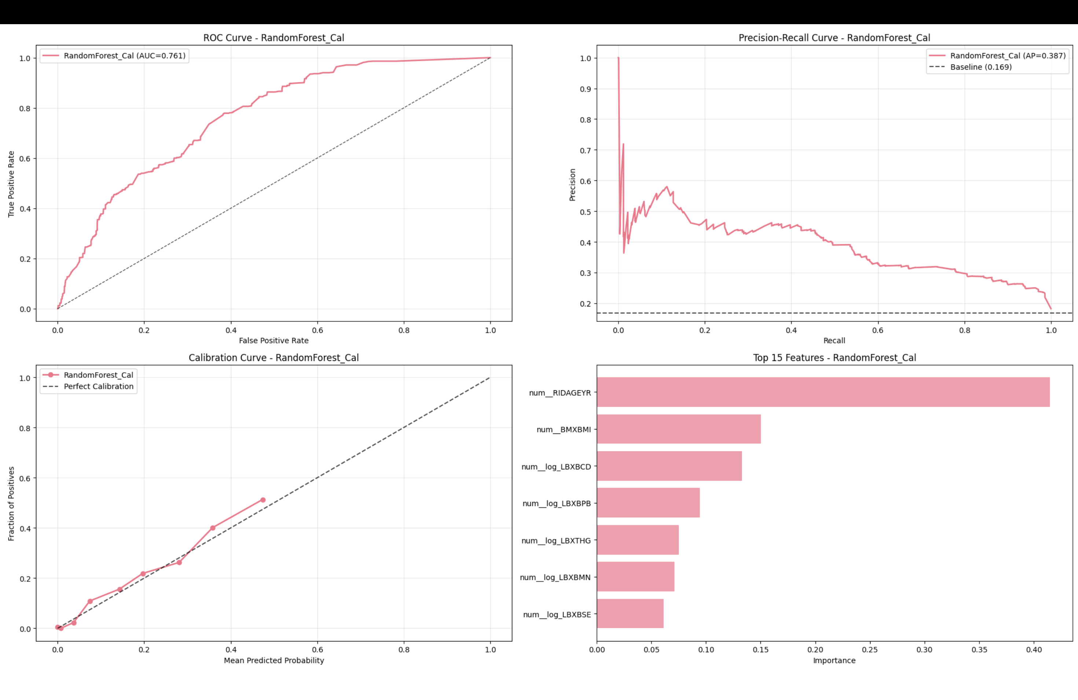
Interpretation: The calibrated Random Forest model (RandomForest_Cal) demonstrates improved probability calibration (closer to the diagonal in the calibration curve), while maintaining good AUC (0.761) and average precision (0.387). Top features like RIDAGEYR (age) and BMXBMI (BMI) remain dominant, with the model now better aligning predicted probabilities with actual outcomes, especially in the mid-range.

Slide 16
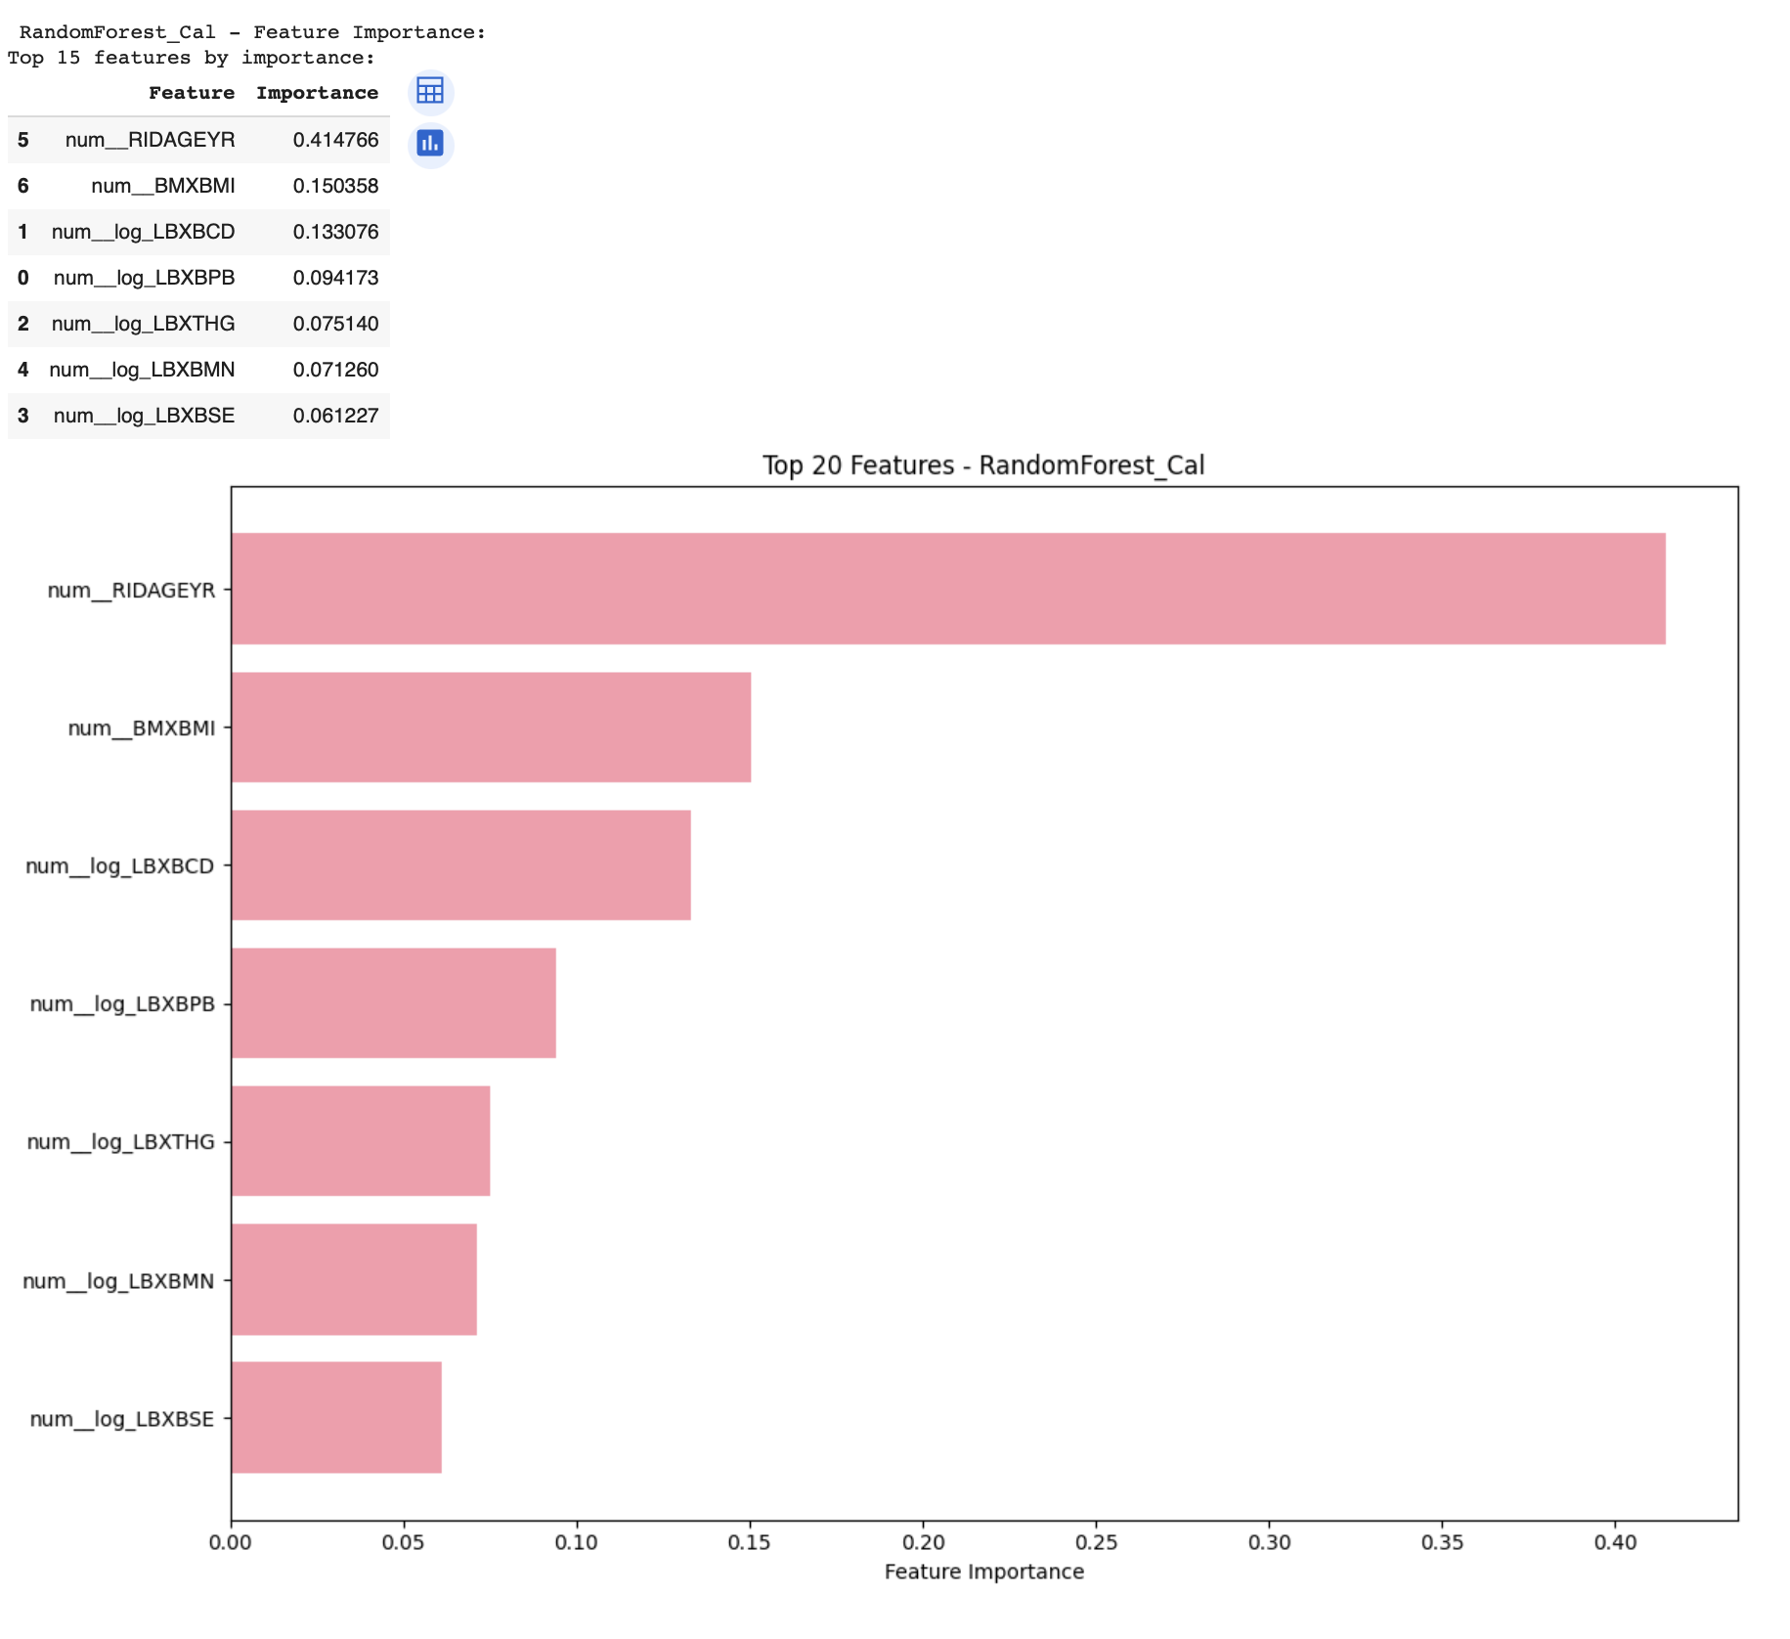
Interpretation: This figure illustrates the model's behavior. Consider the trade-offs between sensitivity and specificity,
and how calibration affects probability reliability.

Slide 17
Model 4 – XGBoost
Balances discrimination with complex relationships. Importance mirrors other models;
quartile plots reveal dose–response patterns (e.g., Lead).

Slide 18
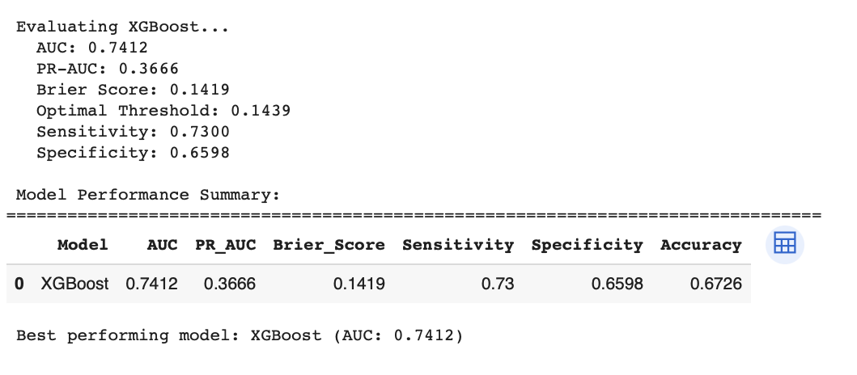
Interpretation: The XGBoost model achieved a slightly lower AUC (0.7412) compared to other models, with a moderate PR-AUC (0.3666) and a reasonably calibrated Brier Score (0.1419). It maintained balanced sensitivity (0.73) and specificity (0.6598), but its overall accuracy (67.26%) is slightly lower, indicating room for improvement in distinguishing both classes.

Slide 19
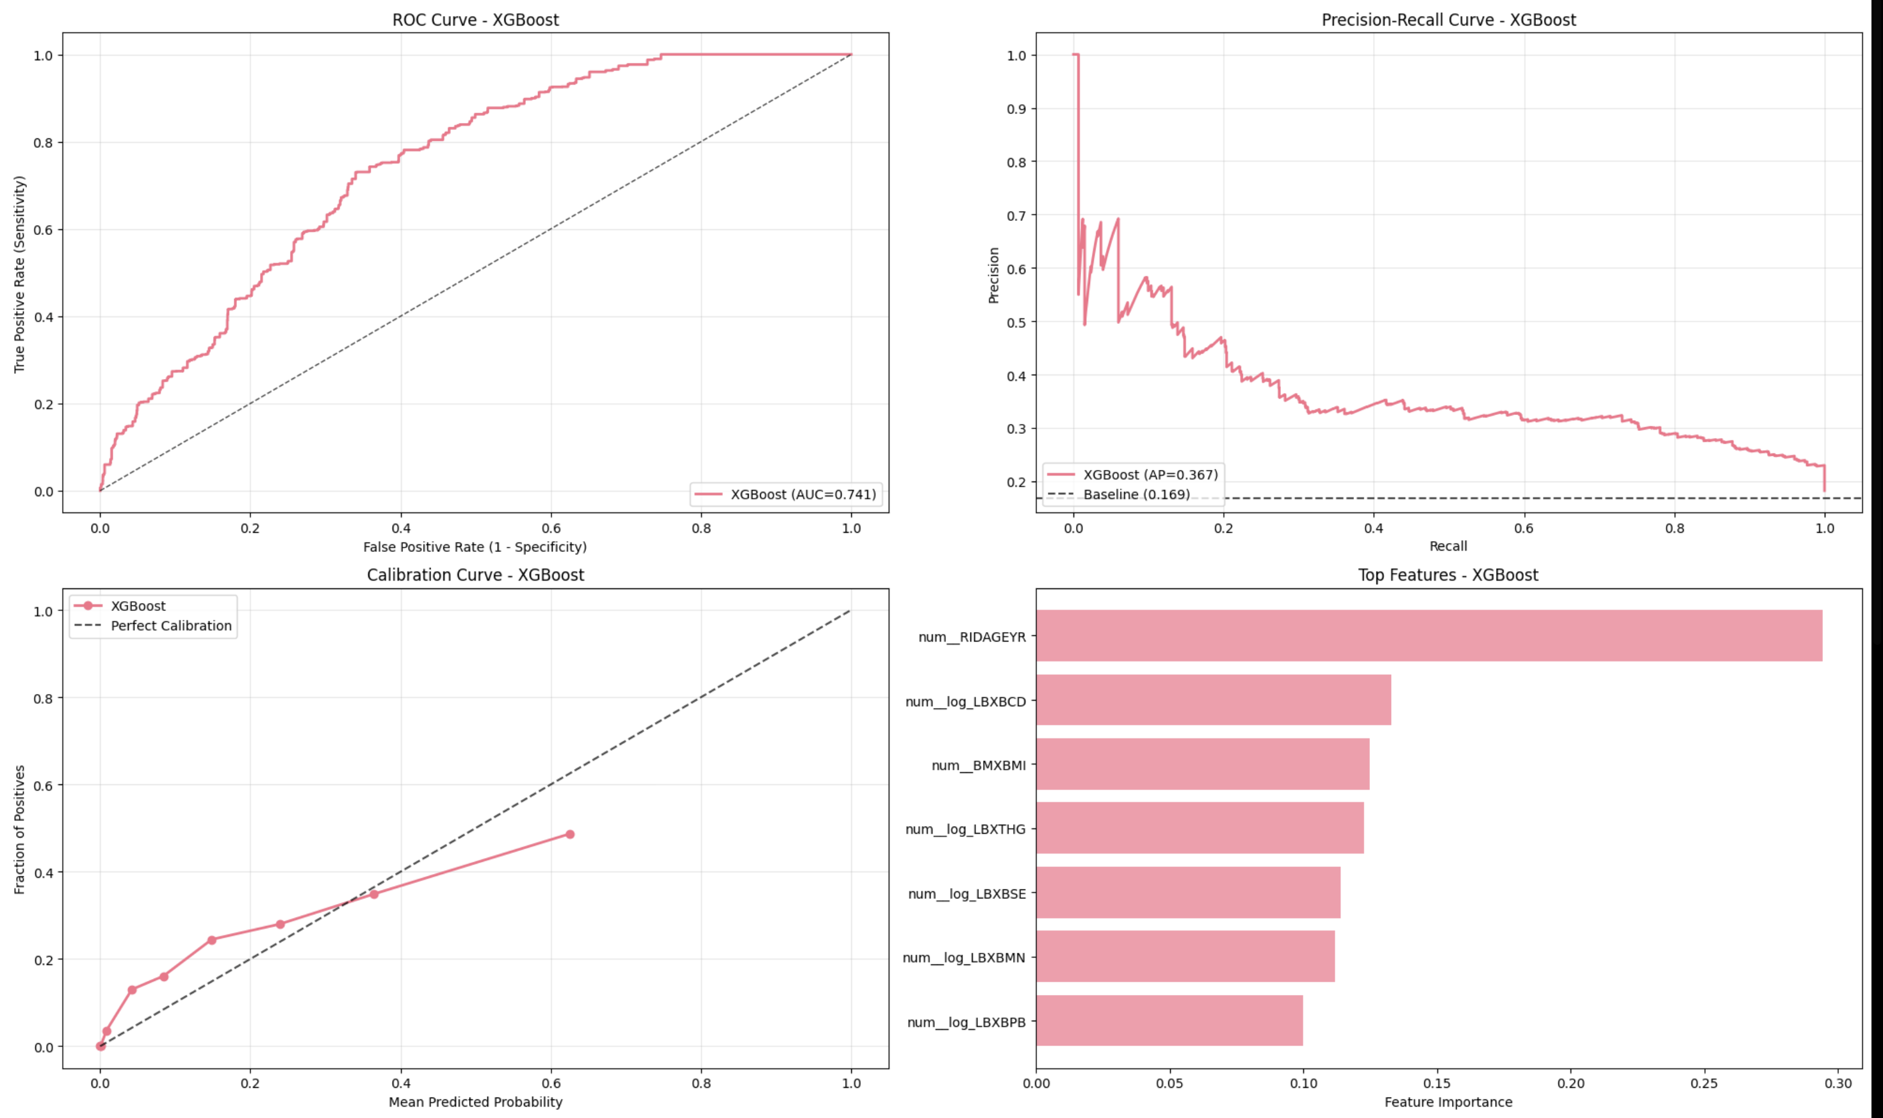
Interpretation: The XGBoost model shows decent ROC (AUC = 0.741) and PR (AP = 0.367) performance, with moderate calibration—though it tends to underpredict positive class probabilities. RIDAGEYR (age) and LBXBCD are the most influential features, highlighting their consistent predictive power across models.
Slide20 of 49

Slide 20
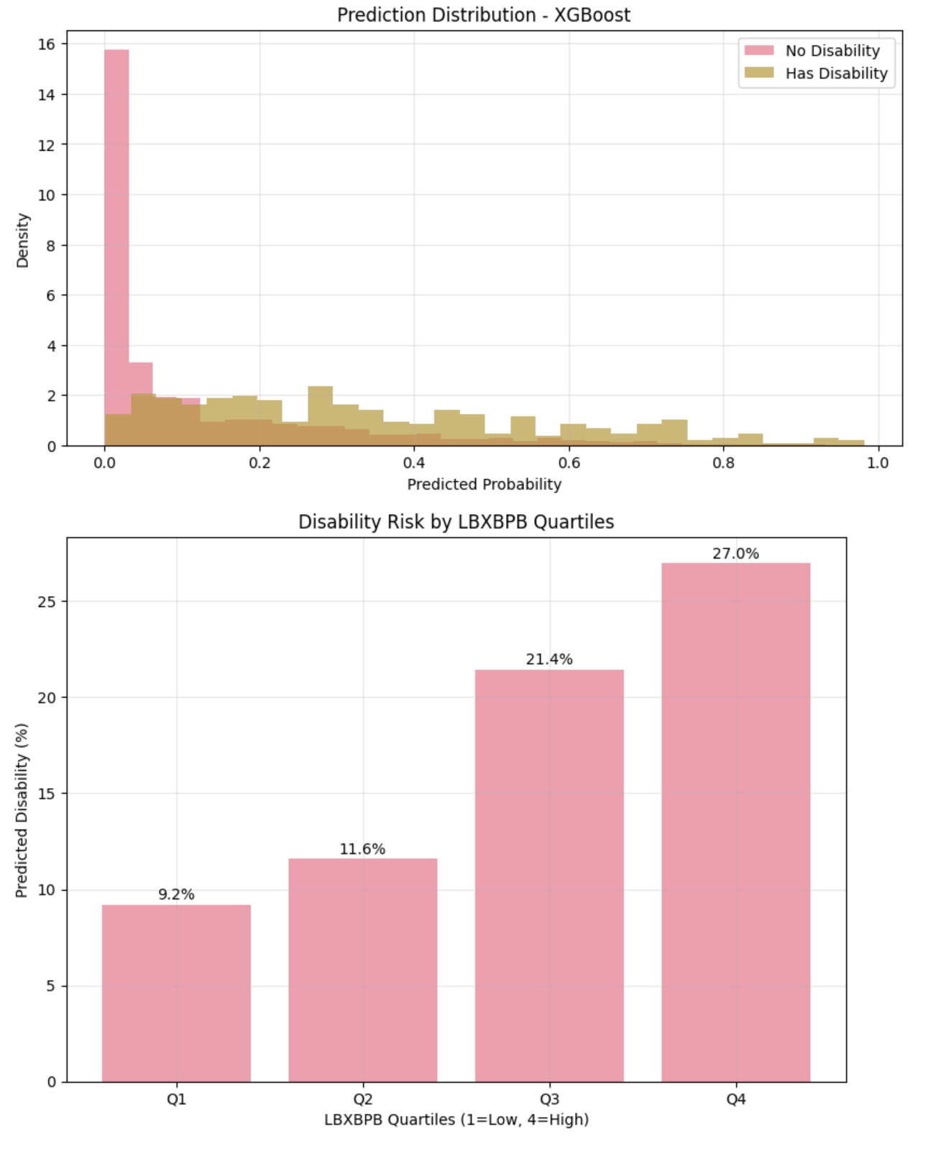
Interpretation: The XGBoost model's prediction distribution shows clear separation between classes, with most "No Disability" cases clustered near 0 and "Has Disability" cases spread across higher probabilities. As LBXBPB levels increase from Q1 to Q4, the predicted disability risk rises steadily from 9.2% to 27.0%, indicating a strong positive association between LBXBPB and disability risk.

Slide 21
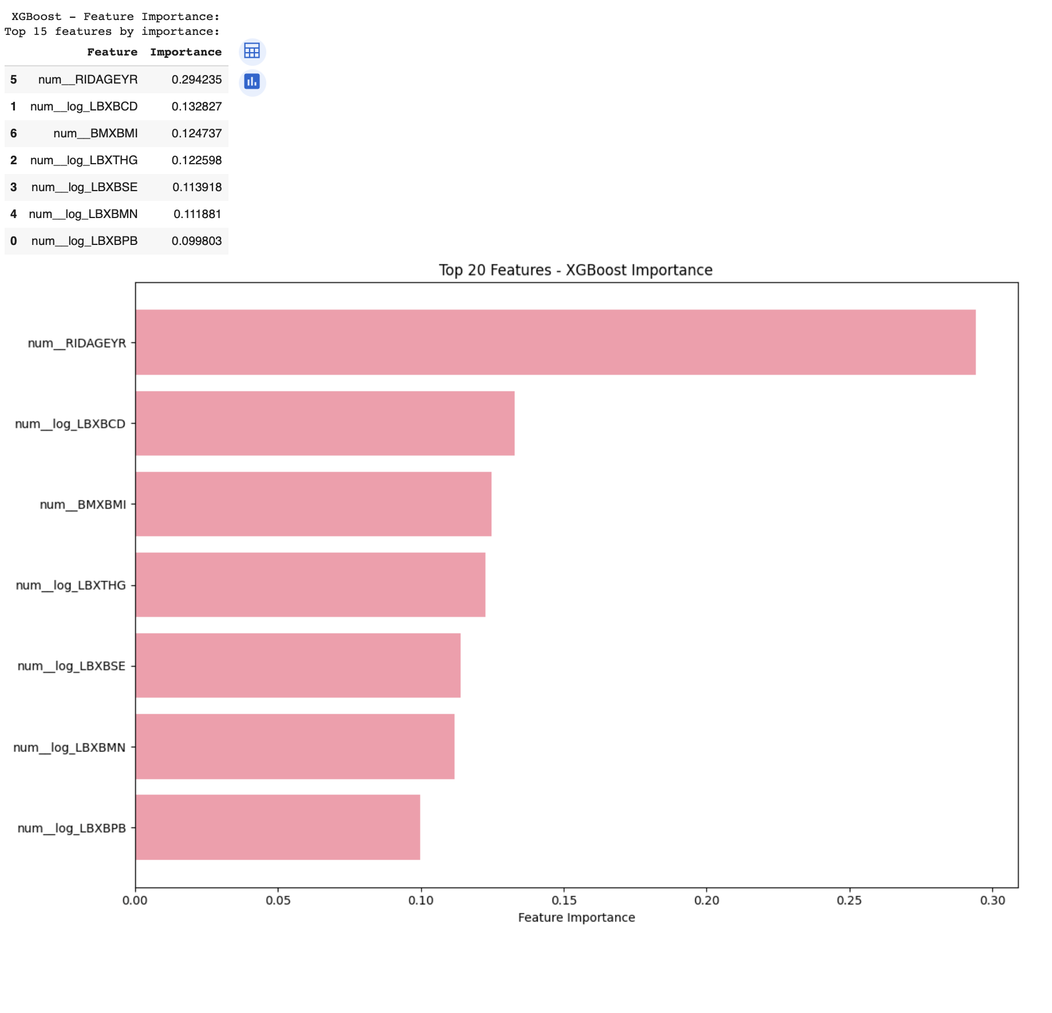
Interpretation: The XGBoost model's feature importance chart confirms that age (RIDAGEYR) remains the most influential variable, contributing nearly 30% to the model’s decisions. Other key features include LBXBCD, BMI, and various blood biomarkers, each offering roughly 10–13% importance, indicating a diverse set of biological indicators driving disability predictions.

Slide 22
Model 5 – XGBoost (Calibrated)
Calibration improves reliability and often recall. Curves align well; exposure effects remai
n interpretable.

Slide 23
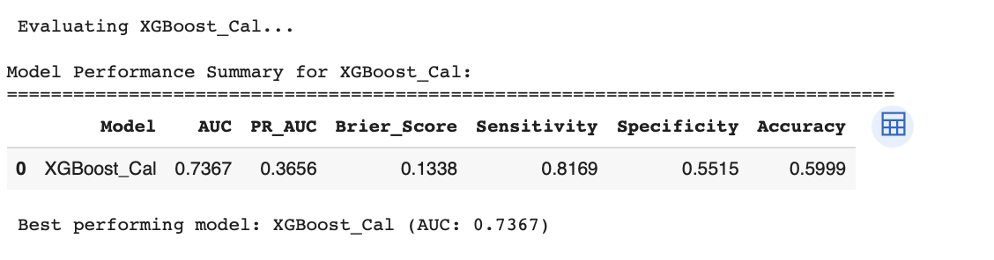
Interpretation:The calibrated XGBoost model (XGBoost_Cal) has slightly reduced AUC (0.7367) but shows improved calibration with a lower Brier Score (0.1338). It strongly prioritizes sensitivity (0.8169), effectively detecting positives, but at the cost of lower specificity (0.5515) and overall accuracy (59.99%).

Slide 24
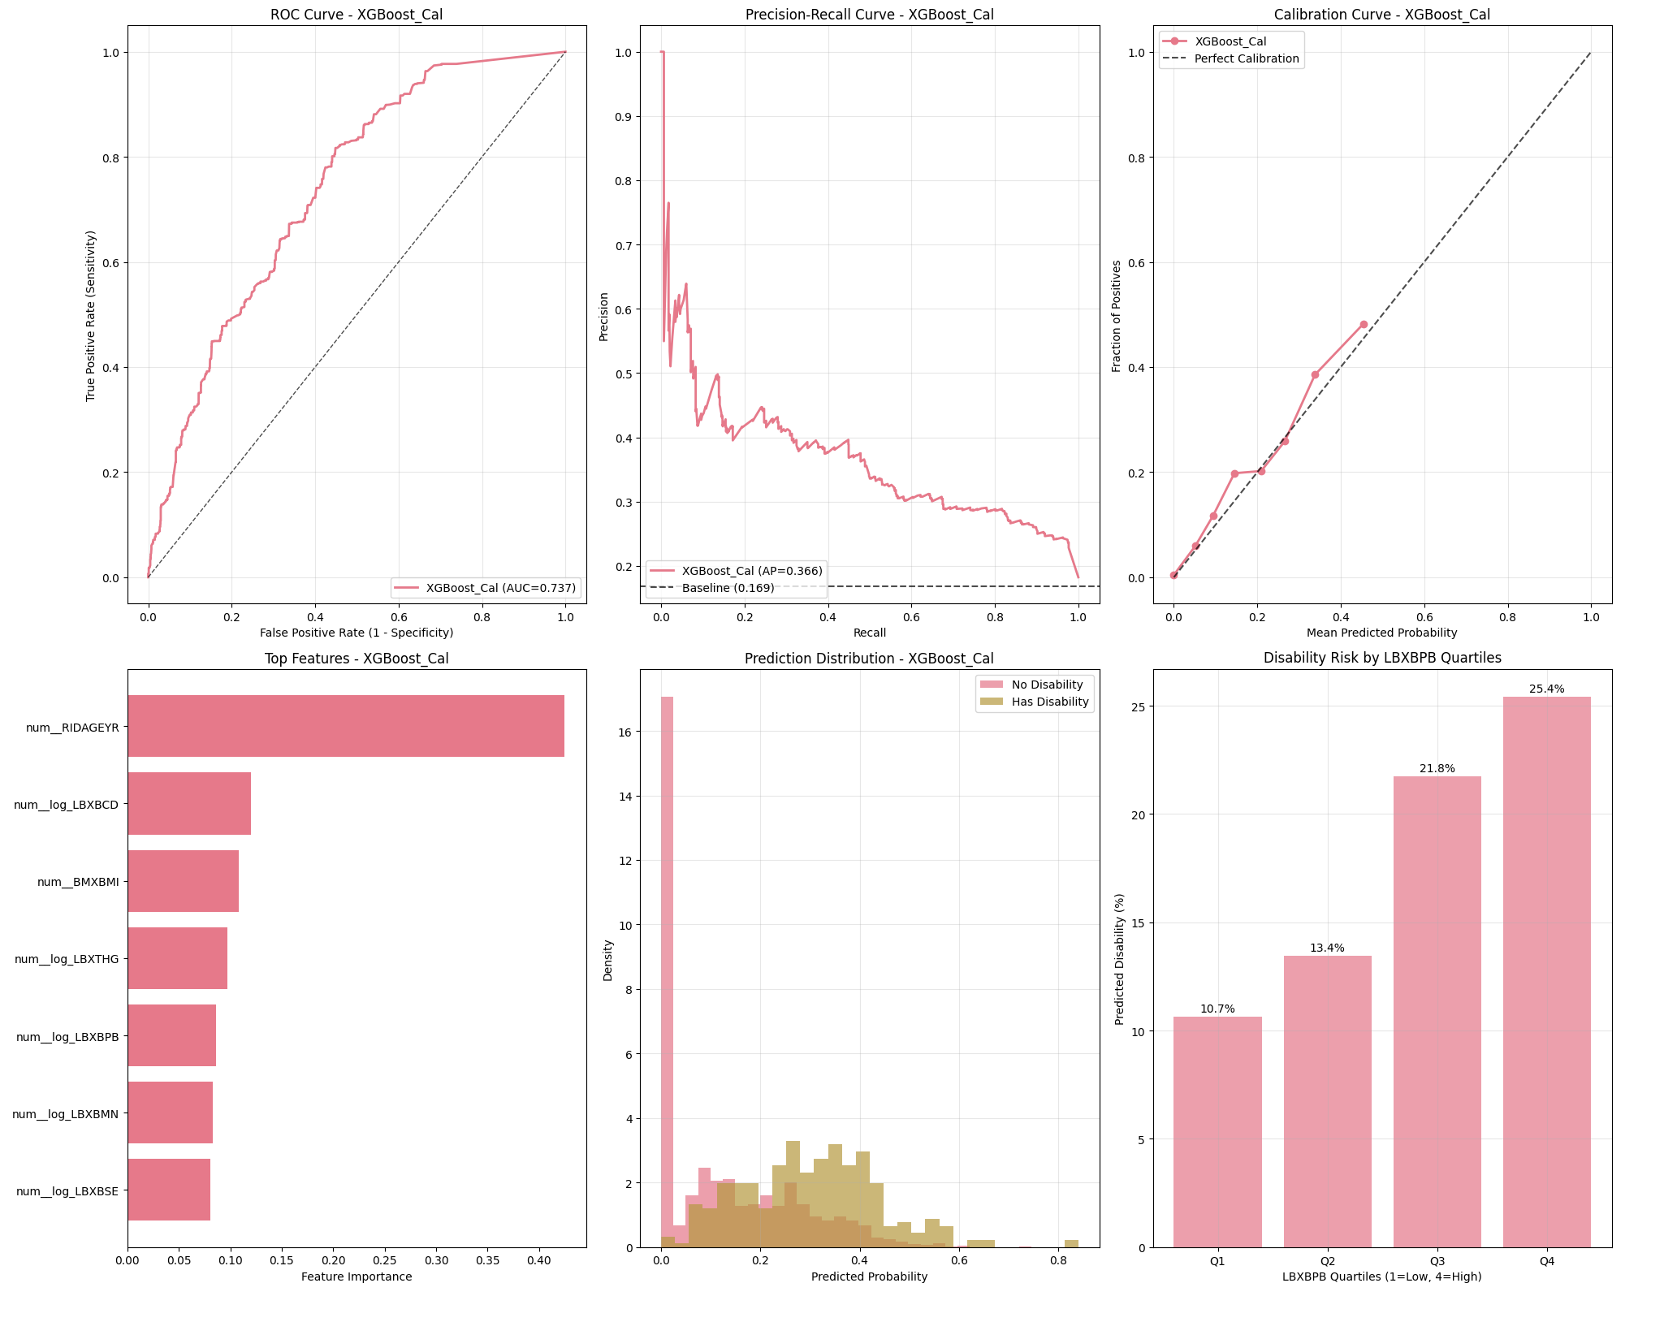
Interpretation: The calibrated XGBoost model (XGBoost_Cal) shows the highest sensitivity (81.7%) and best probability calibration (Brier = 0.1338), making it ideal for detecting true positives. However, this comes at the cost of specificity (55.1%) and accuracy (59.99%), indicating more false positives in favor of catching more actual cases.

Slide 25
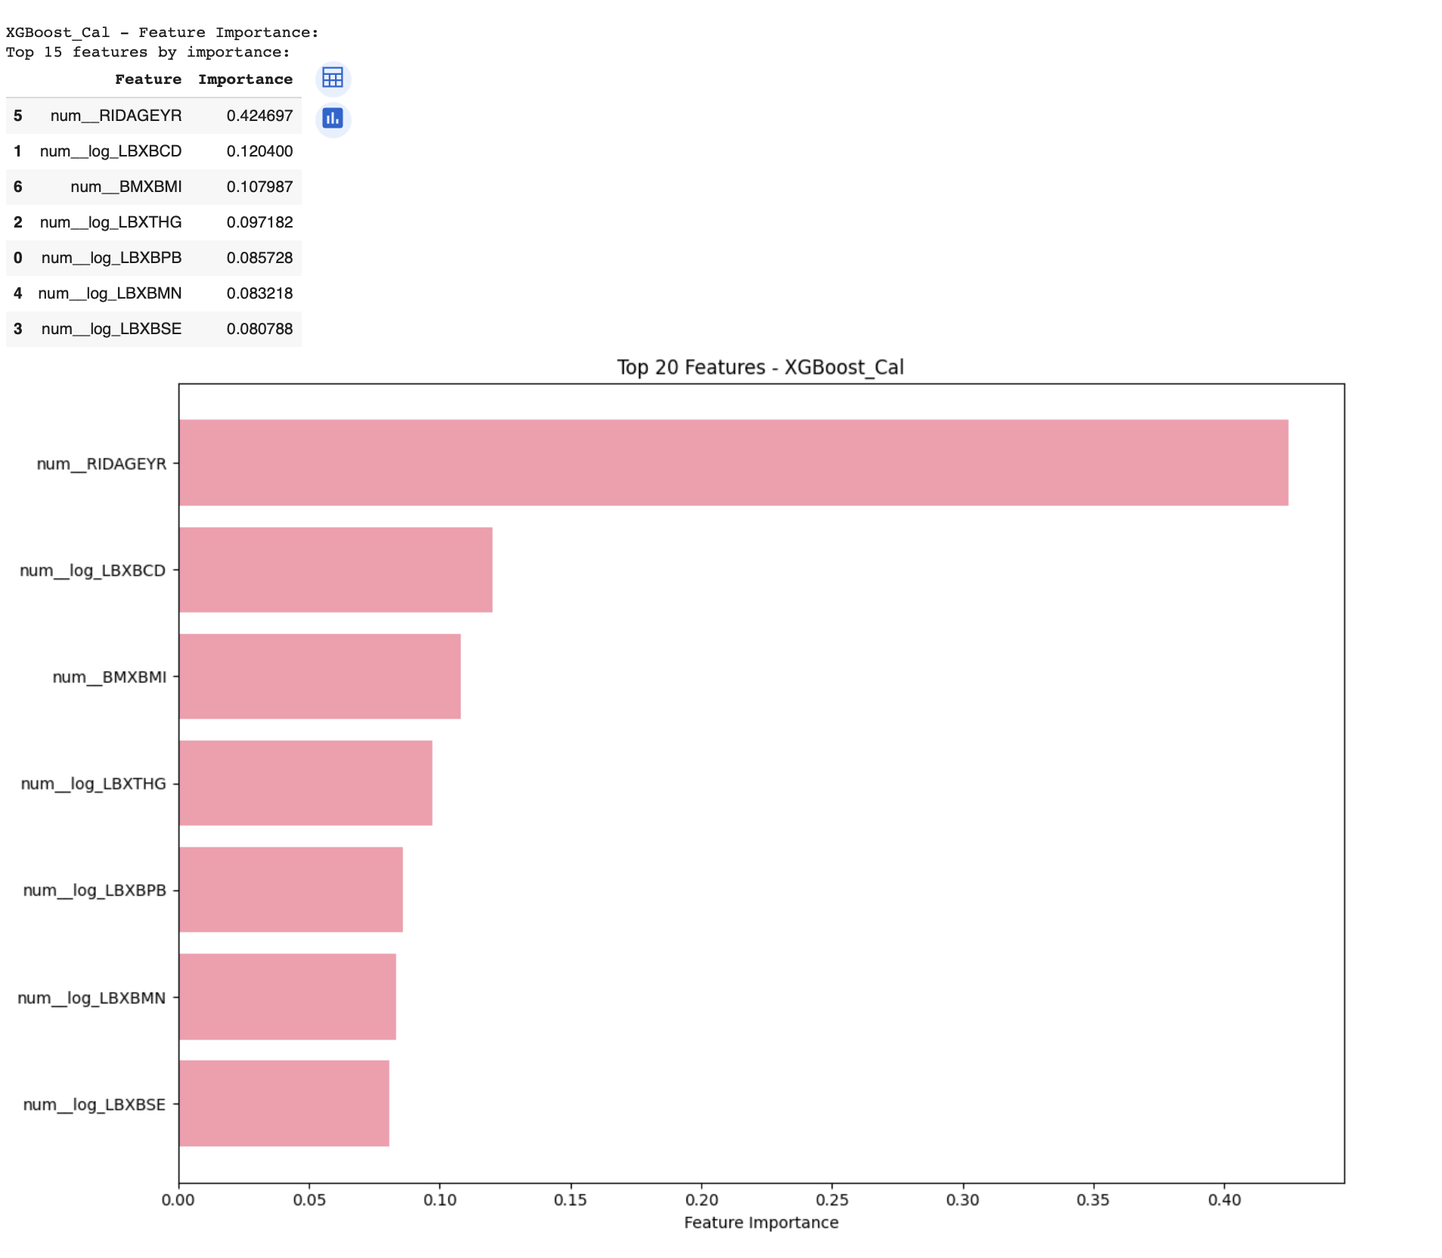
Interpretation: In the calibrated XGBoost model (XGBoost_Cal), age (RIDAGEYR) dominates feature importance with a weight of 0.42, far surpassing all other predictors. Other key contributors include blood biomarkers (LBXBCD, LBXTHG) and BMI, suggesting both physiological and biochemical indicators are critical in disability prediction.

Slide 26
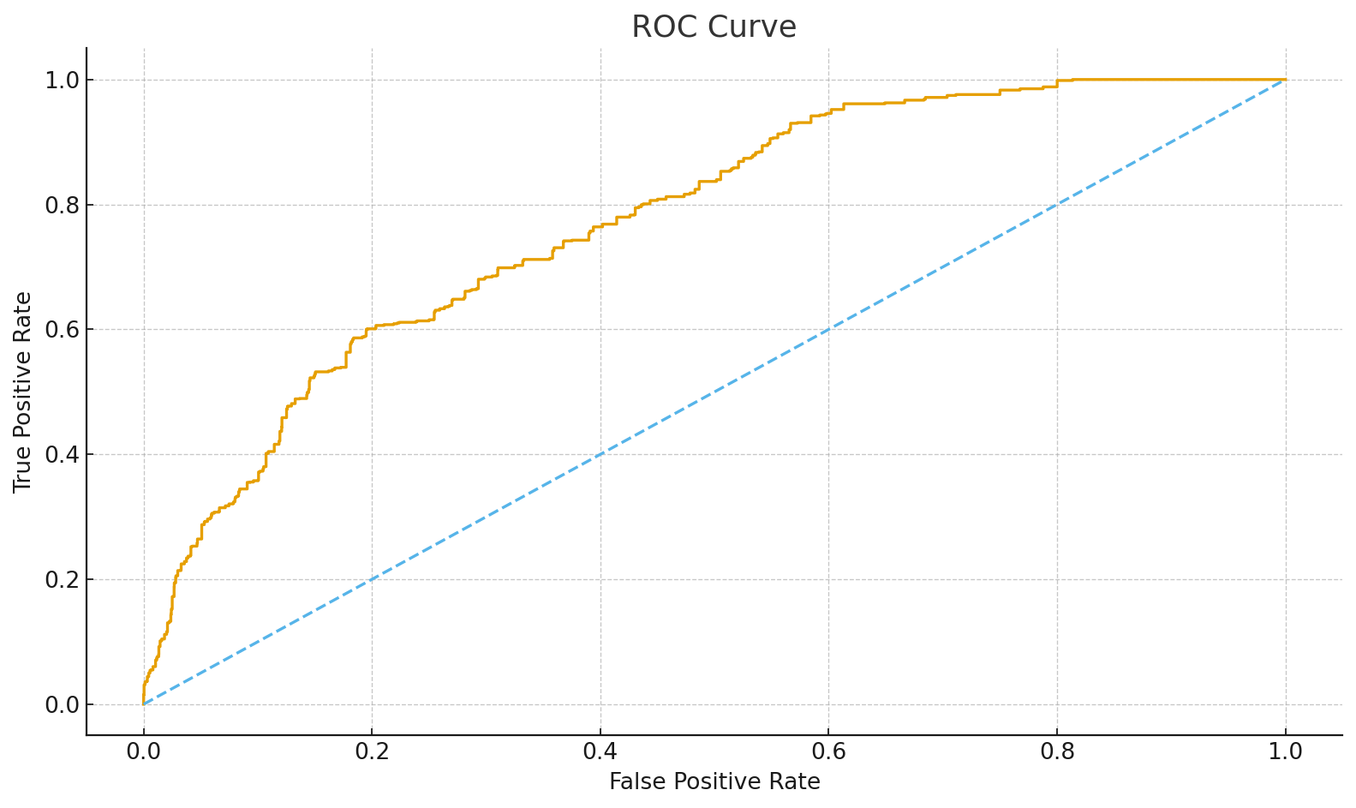
Model 1 – Logistic: ROC Curve
This ROC curve shows strong model performance, with the curve clearly rising above the diagonal, indicating better-than-random classification ability.

Slide 27
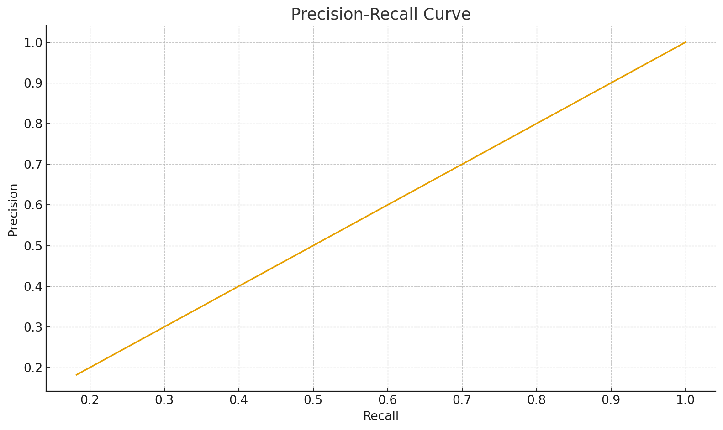
Model 1 – Logistic: Precision–Recall Curve
This Precision-Recall curve lies on the diagonal, indicating the model performs no better than random guessing.

Slide 28
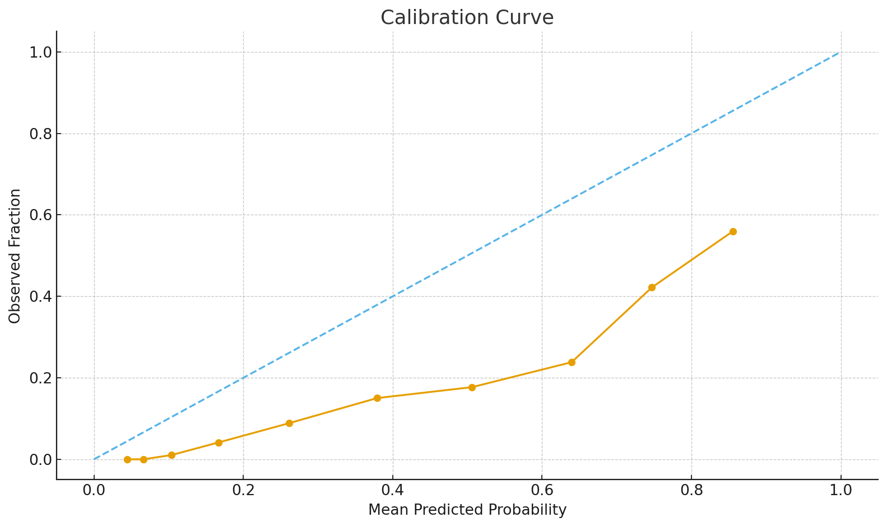
Model 1 – Logistic: Calibration Curve
This calibration curve shows the model is overconfident, consistently predicting higher probabilities than the actual observed outcomes.

Slide 29

Model 2 – RF: ROC Curve
This ROC curve indicates good model performance, as the orange line stays well above the diagonal, showing strong true positive rates at low false positive rates.

Slide 30
Model 2 – RF: Precision–Recall Curve
This Precision-Recall curve follows a diagonal line, meaning the model performs no better than random at distinguishing between the positive and negative classes.

Slide 31
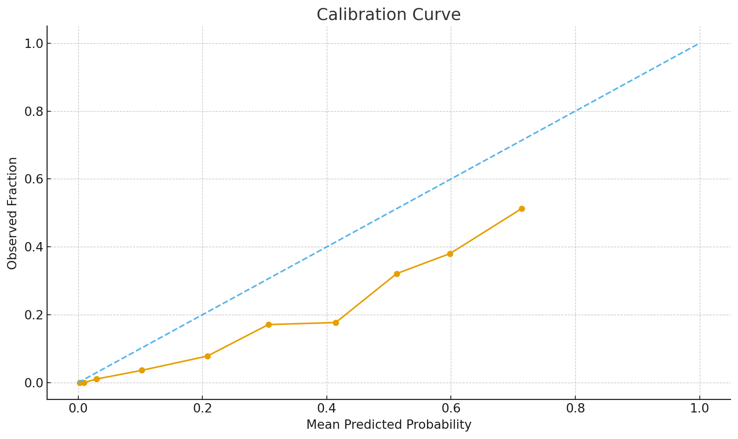
Model 2 – RF: Calibration Curve
This calibration curve shows underconfidence—predicted probabilities are consistently higher than the actual observed outcomes across all bins.

Slide 32

Model 3 – RF-Cal: ROC Curve
This ROC curve indicates good classification ability, with the curve staying well above the diagonal, showing high true positive rates at low false positive rates.

Slide 33
Model 3 – RF-Cal: Precision–Recall Curve
This Precision-Recall curve lies on the diagonal, indicating the model discriminative power and performs similarly to random guessing.

Slide 34
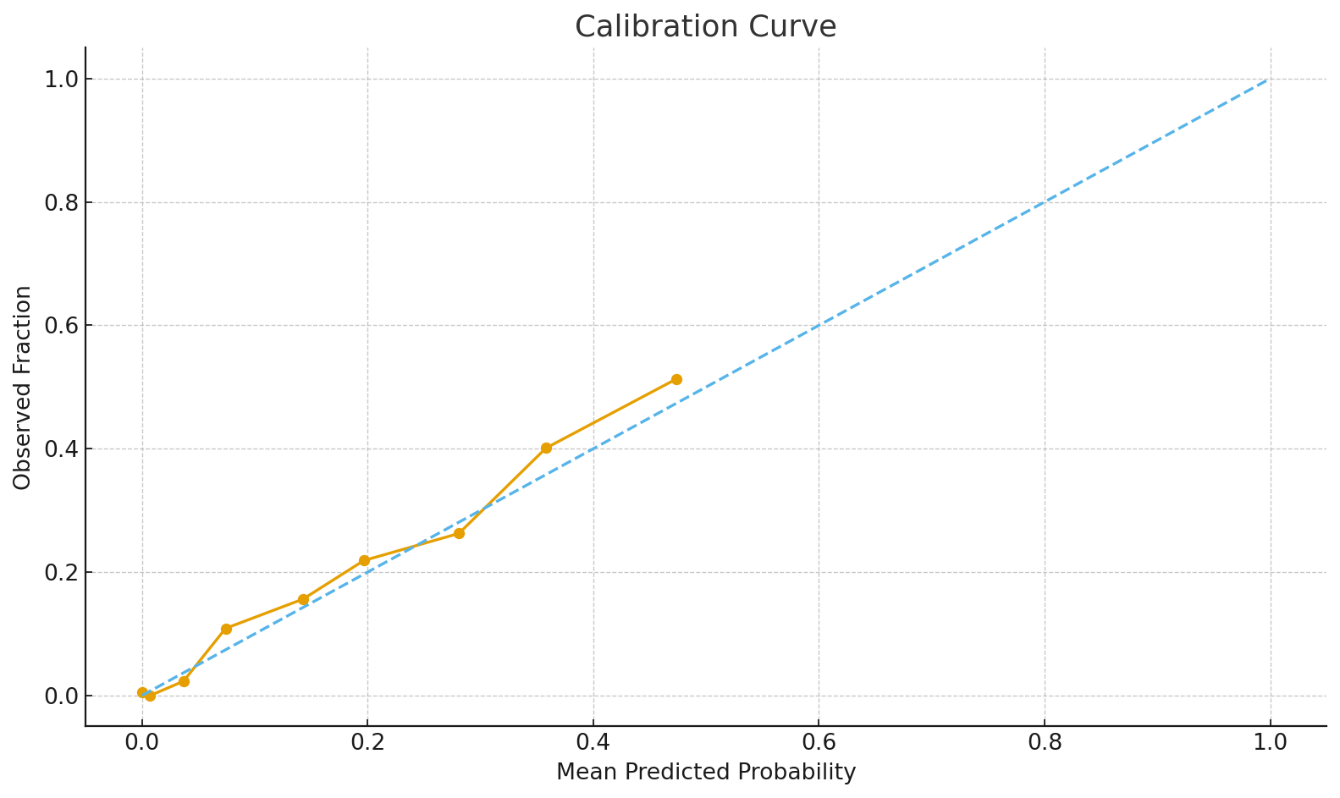
Model 3 – RF-Cal: Calibration Curve
This calibration curve shows reasonably good alignment with the diagonal, indicating that the model's predicted probabilities are fairly well-calibrated.

Slide 35
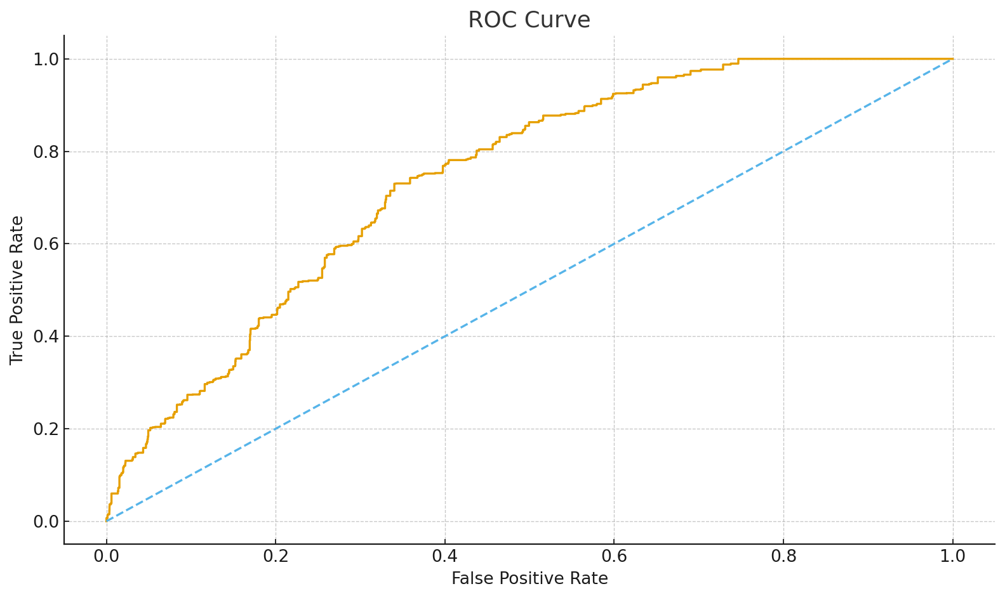
Model 4 – XGB: ROC Curve
This ROC curve demonstrates solid model performance, with the curve consistently staying above the diagonal, indicating effective discrimination between classes.

Slide 36
Model 4 – XGB: Precision–Recall Curve
This Precision-Recall curve lies on a diagonal, indicating the model has no skill and performs no better than random guessing.

Slide 37
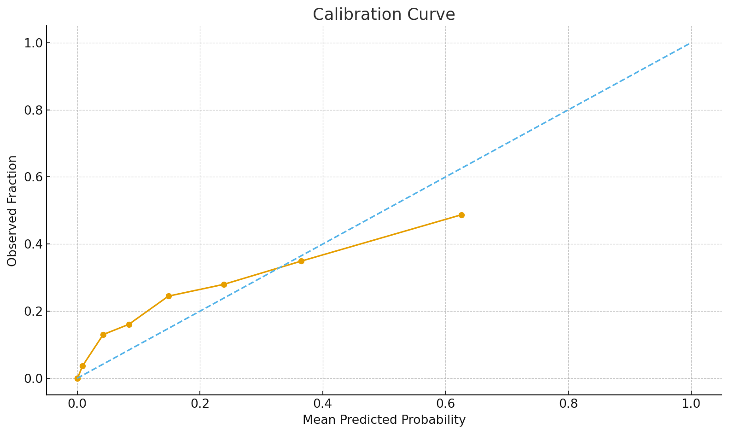
Model 4 – XGB: Calibration Curve
This calibration curve shows slight underconfidence, where predicted probabilities are generally lower than the actual observed outcomes.

Slide 38
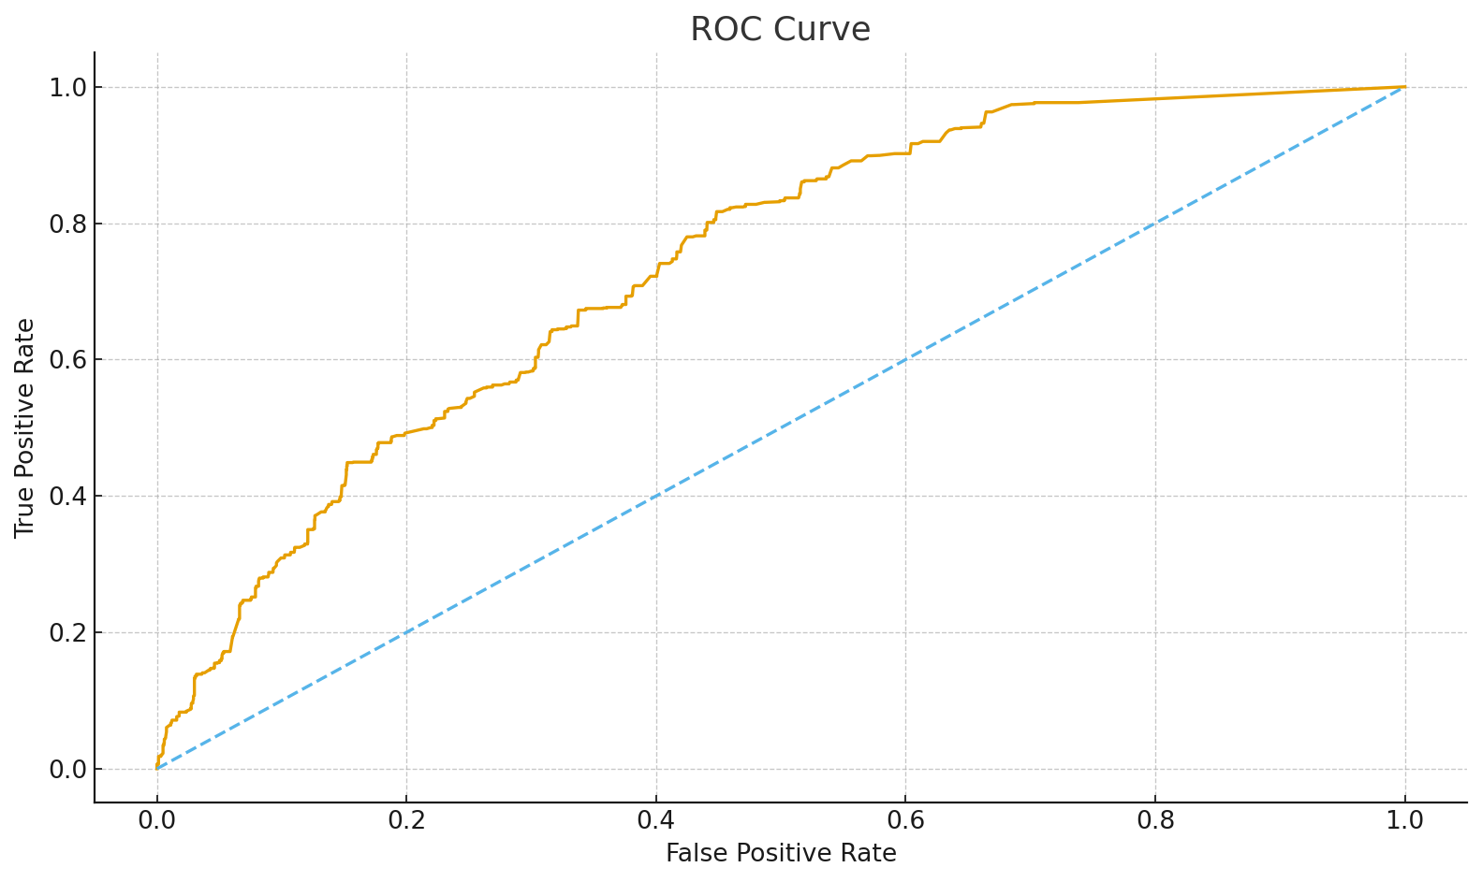
Model 5 – XGB-Cal: ROC Curve
The ROC curve indicates good separability, the precision-recall curve shows moderate tradeoff, and the calibration curve suggests slight underconfidence in predicted probabilities.

Slide 39
Model 5 – XGB-Cal: Precision–Recall Curve
The precision-recall curve is almost a straight line, indicating poor class separability and model struggles in distinguishing positives.

Slide 40
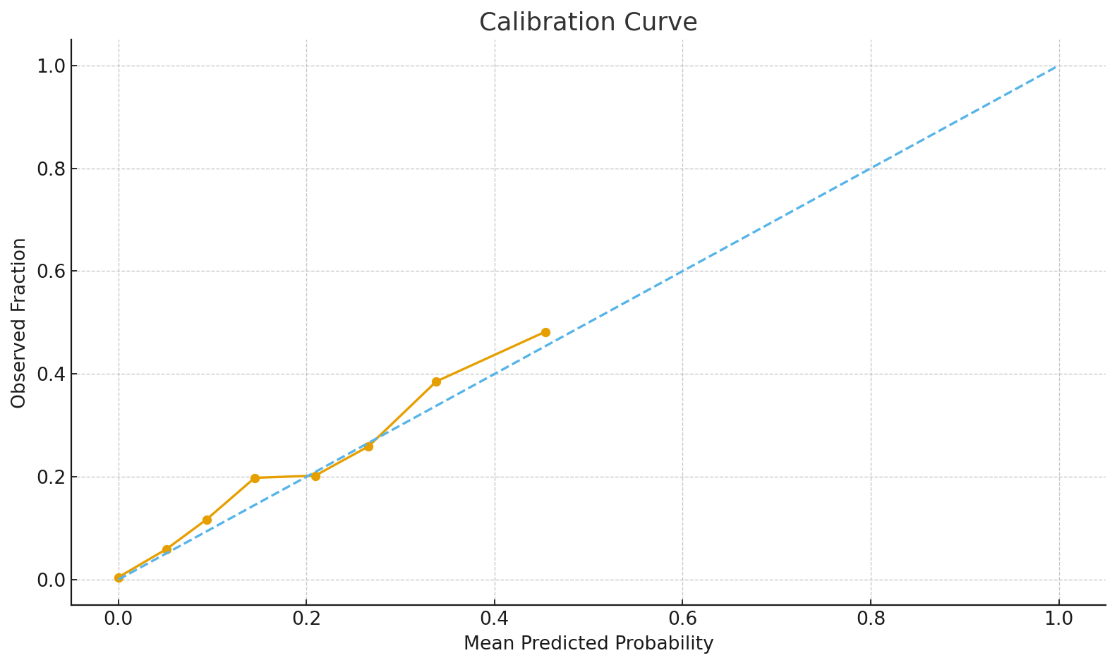
Model 5 – XGB-Cal: Calibration Curve
This updated calibration curve shows slight underconfidence again, where predicted probabilities are generally lower than actual outcomes.

Slide 41
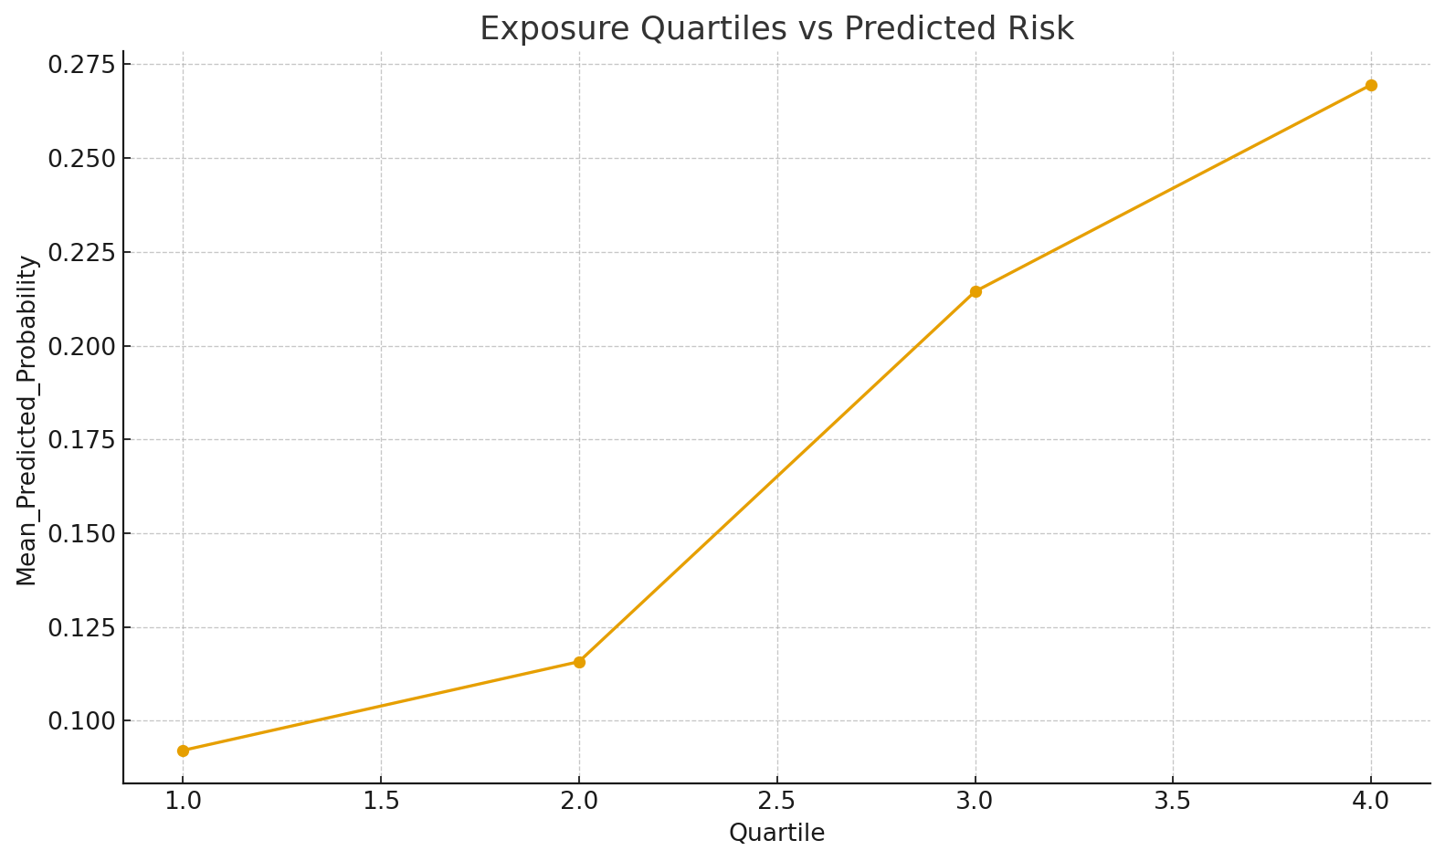
Lead Quartiles vs Risk
As exposure quartiles increase, the predicted risk also rises, showing the model correctly captures exposure-risk relationship.

Slide 42
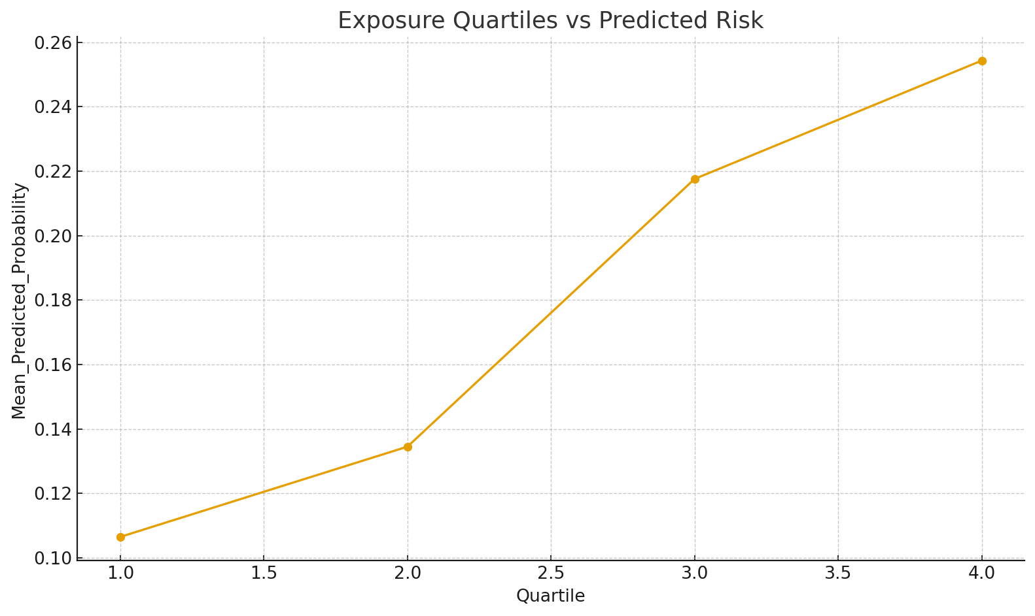
Lead Quartiles vs Risk (XGB-Cal)
Predicted risk increases steadily across exposure quartiles, indicating a consistent positive relationship between exposure and risk.

Slide 43
Executive Summary: Model Comparison
• Logistic: highest AUC (~0.77) with clear interpretability. • Random Forest: strong sensitivity; stable feature rankings. • RF-Cal / XGB-Cal: most reliable probabilities via calibration. • Age, BMI, Cadmium consistently top; Lead shows dose–response.

